Slide 1
CSE 11 Accelerated Intro to Programming Lecture 10
Greg Miranda, Spring 2021
This lecture is being recorded

Slide 2
Announcements
Quiz 10 due Wednesday @ 8am
PA3 due Wednesday @ 11:59pm
Survey 4 due tonight @ 11:59pm

Slide 3
WeeklyPay
weeklyPay: takes a number of hours worked and an hourly rate, and returns the pay with overtime (over 40 hours) counting as double the rate

Slide 4
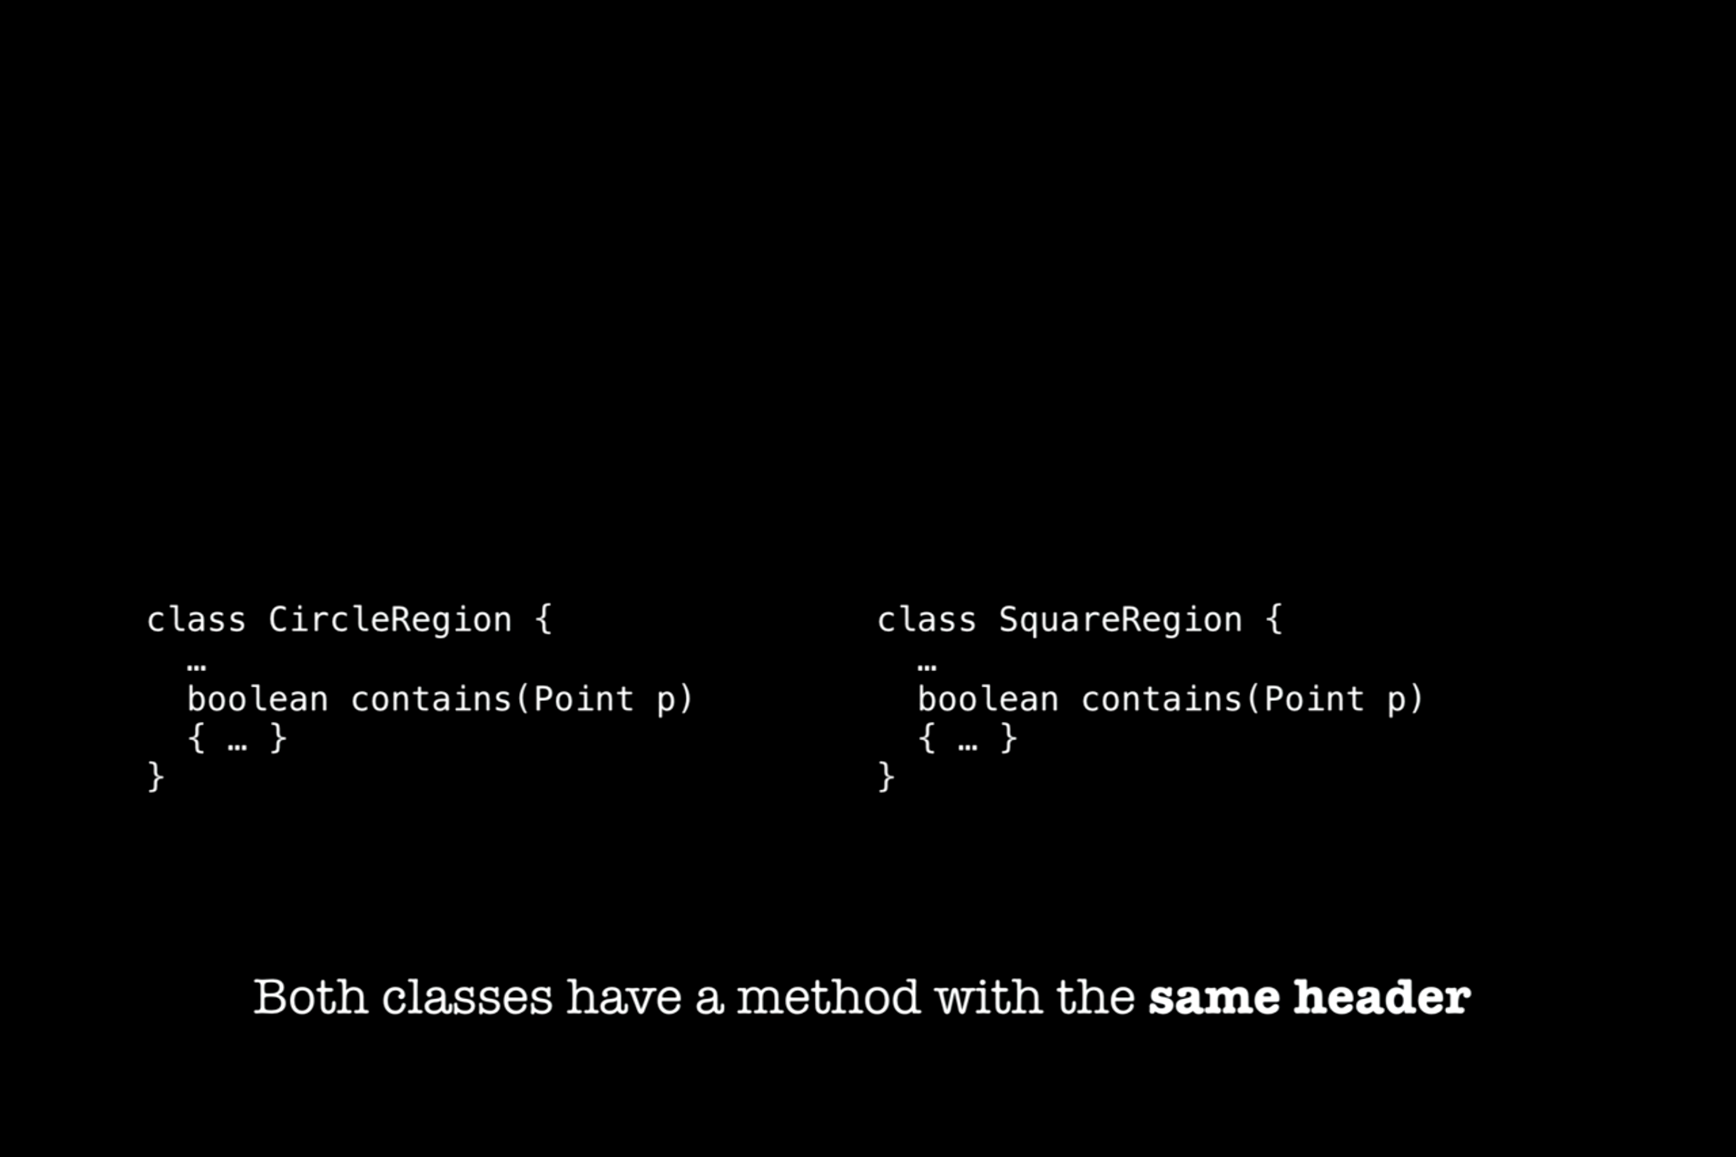

Slide 5
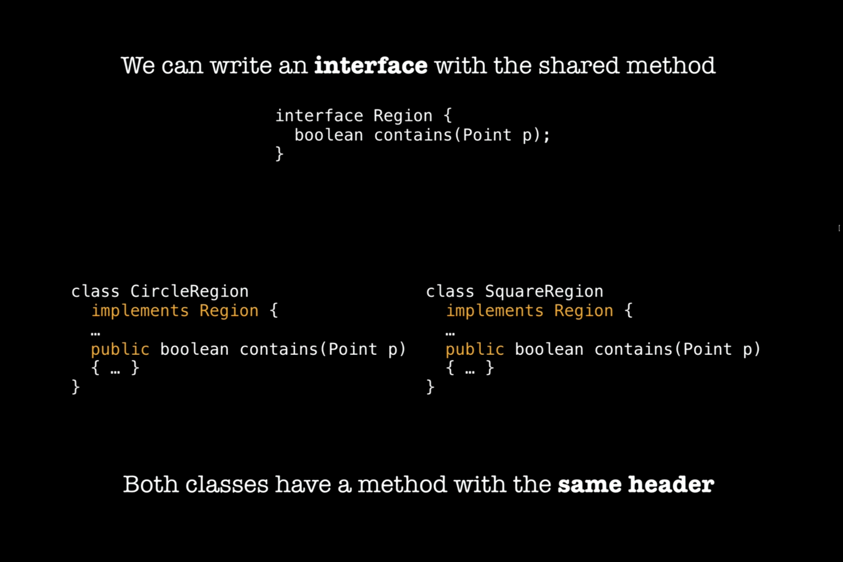

Slide 6
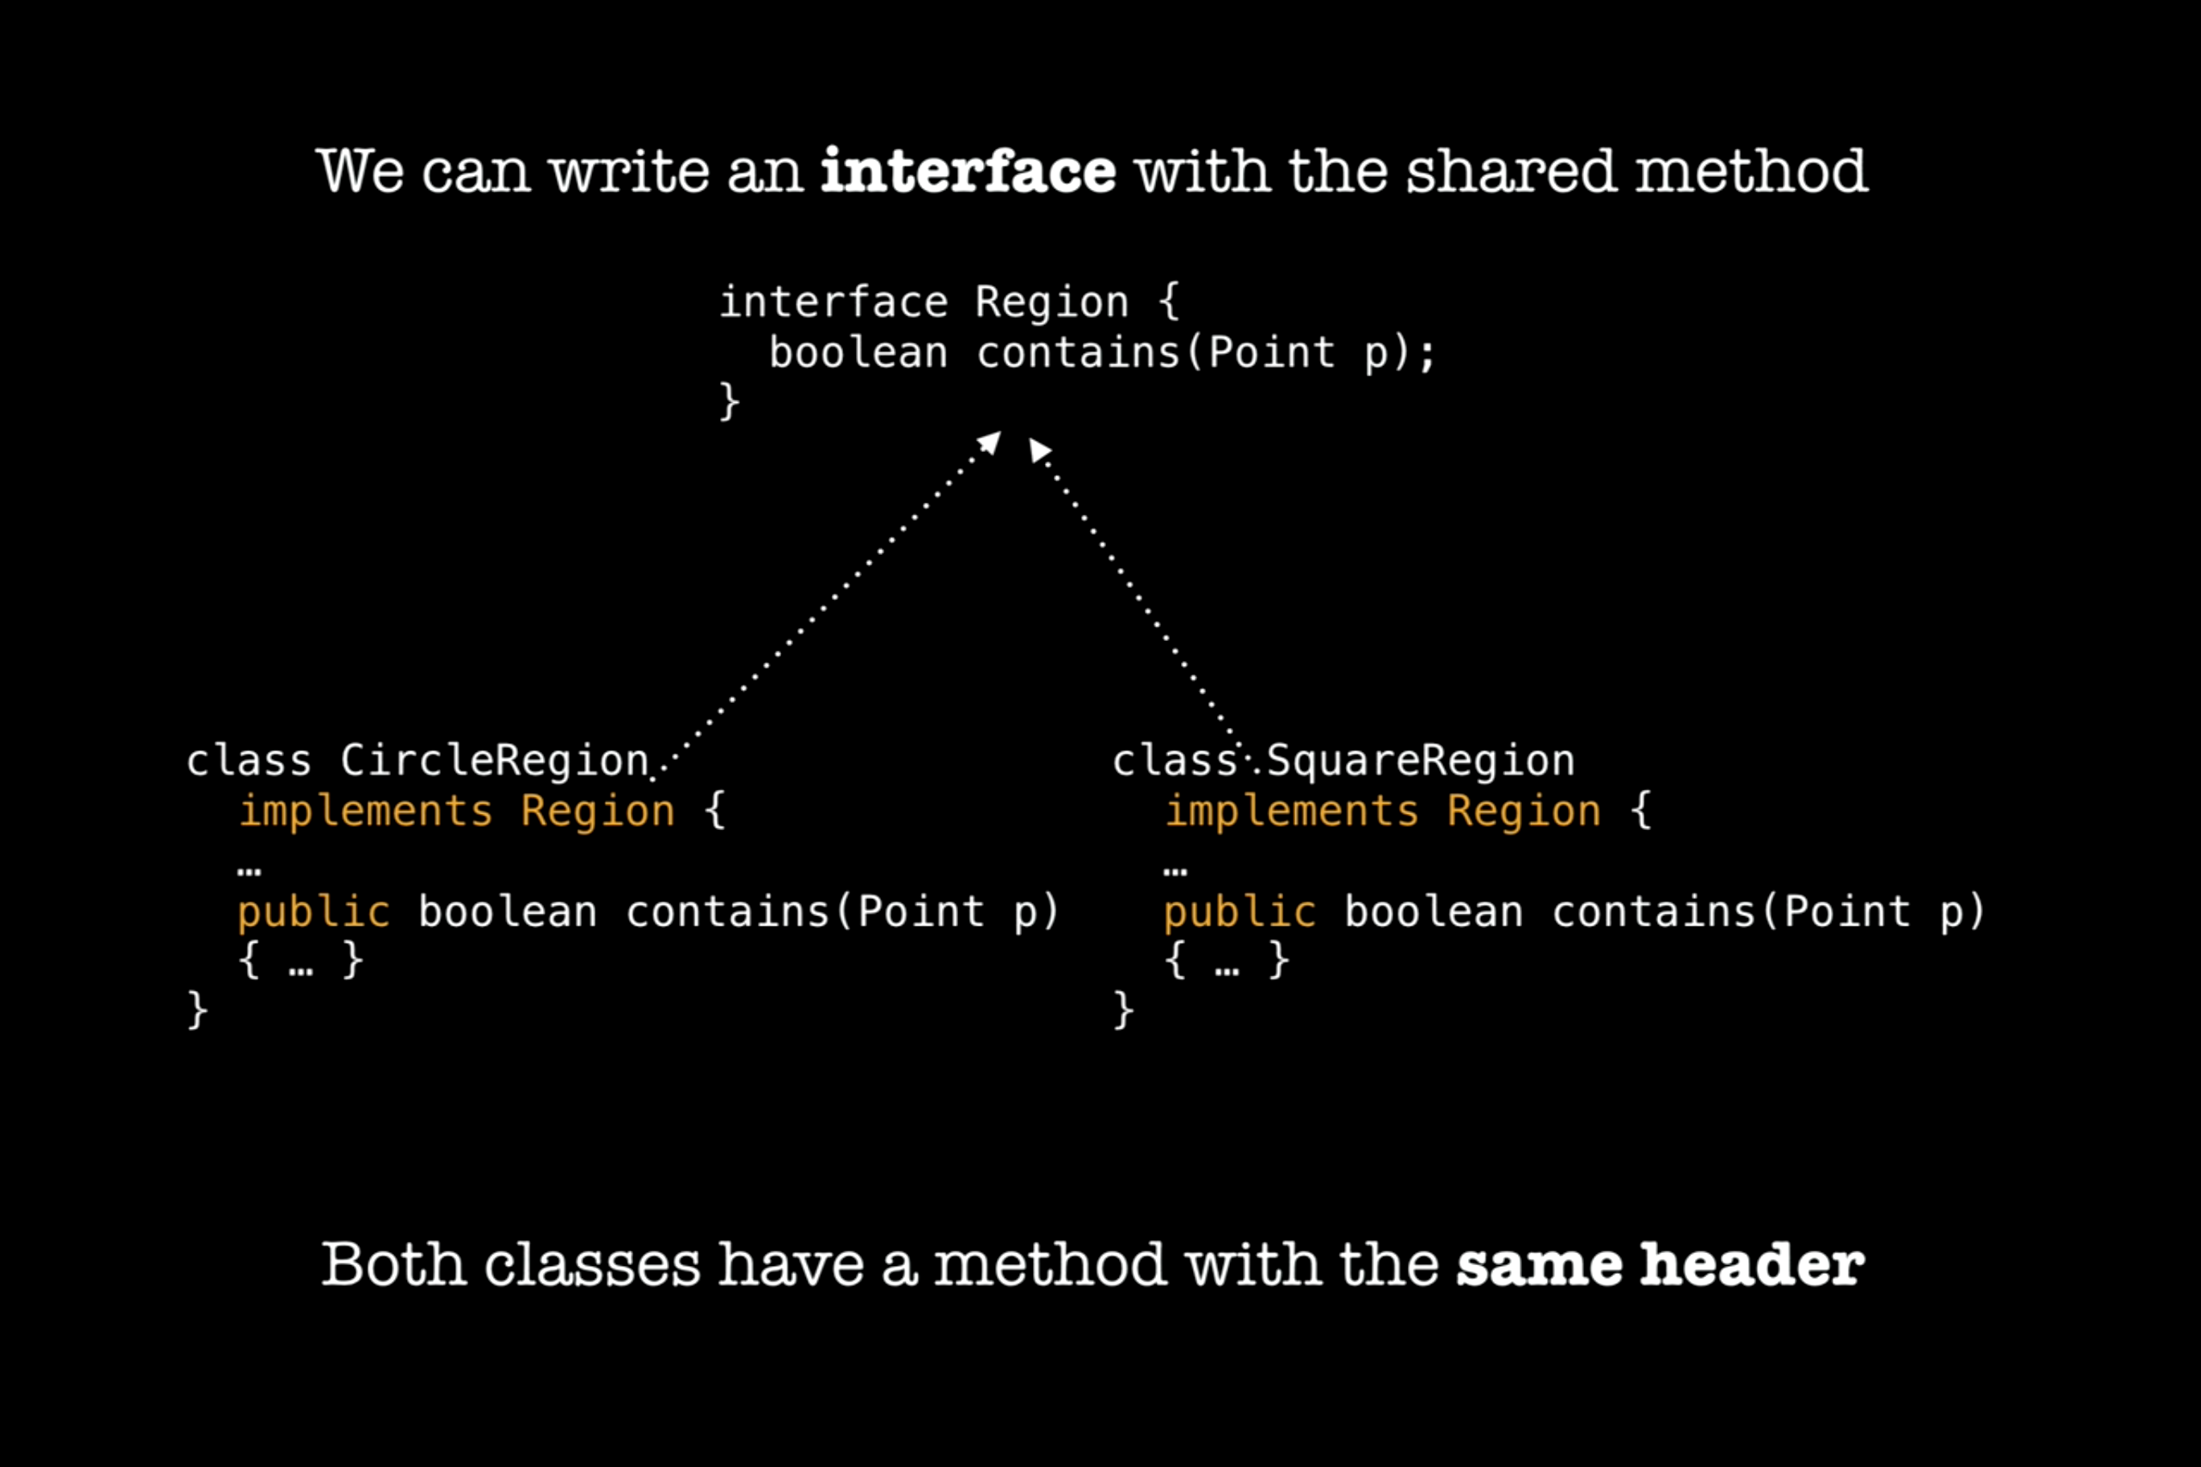

Slide 7
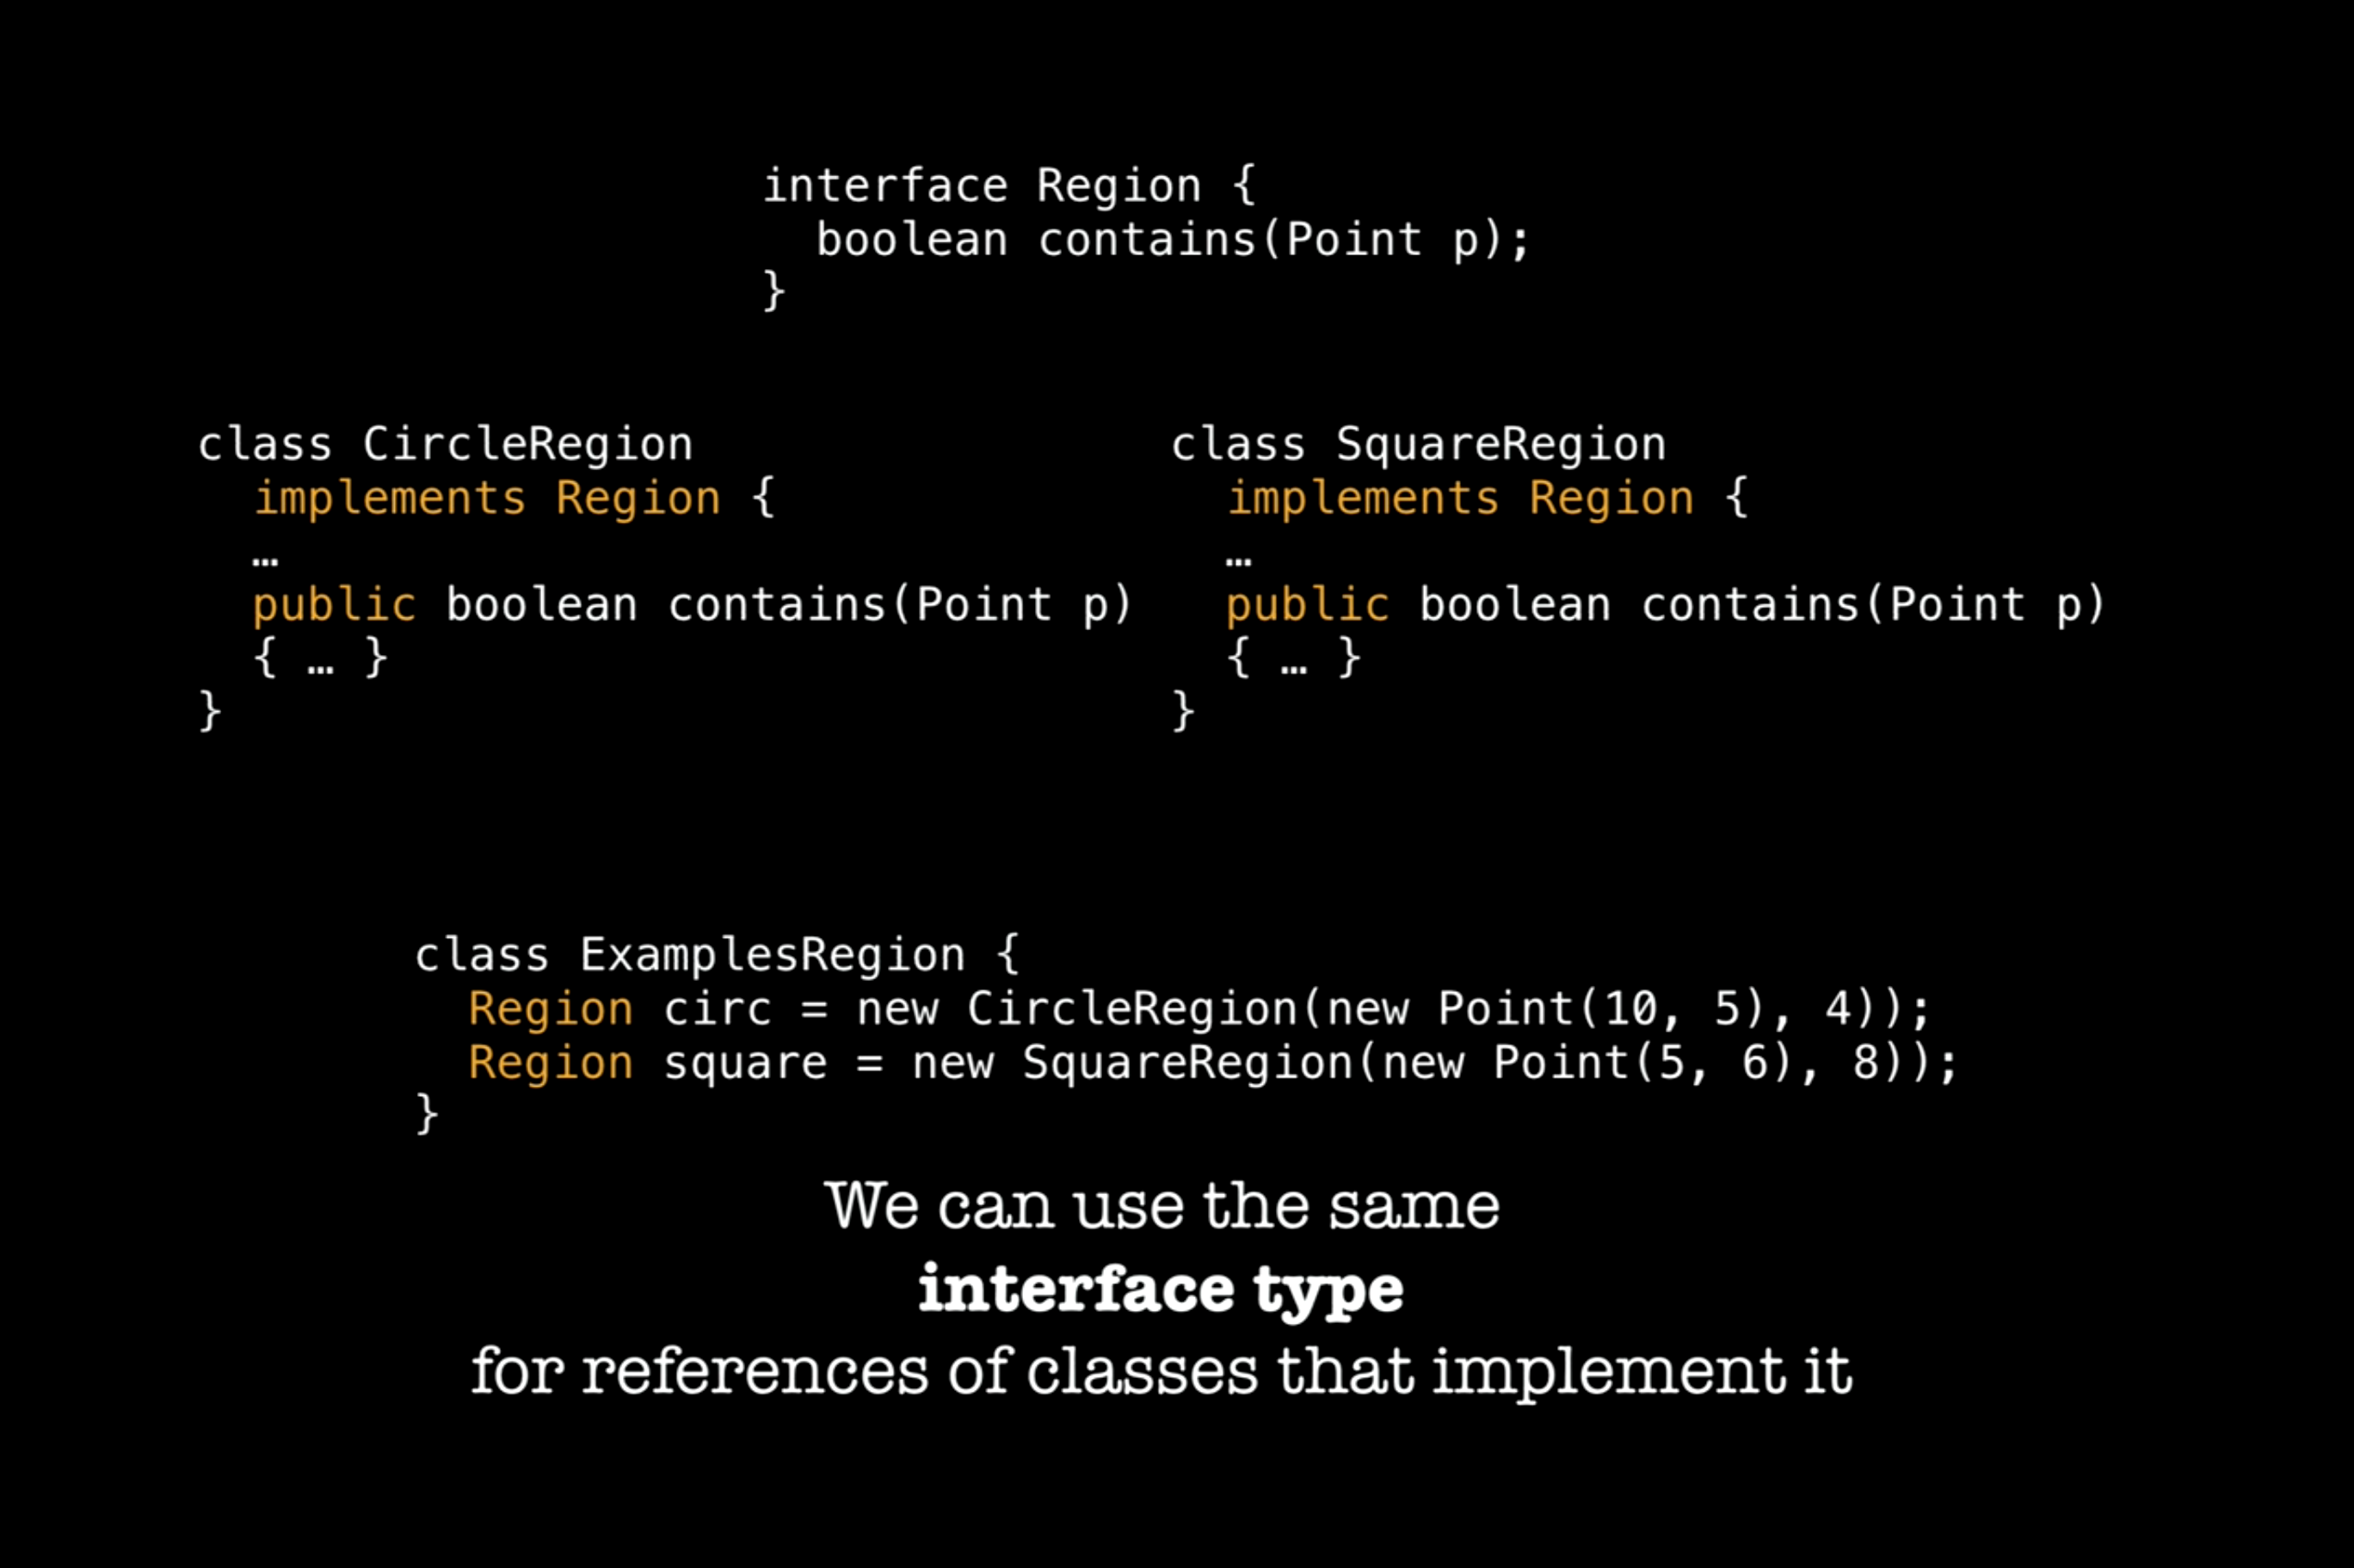

Slide 8
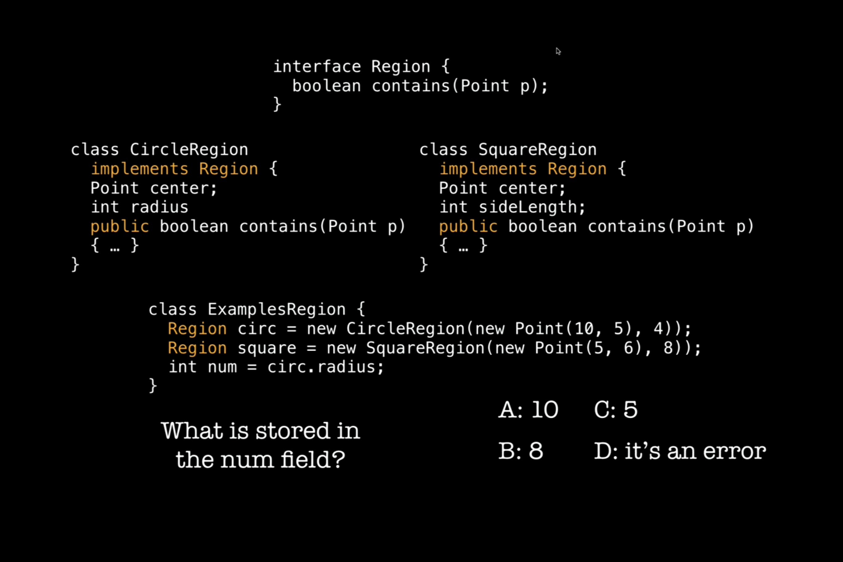

Slide 9
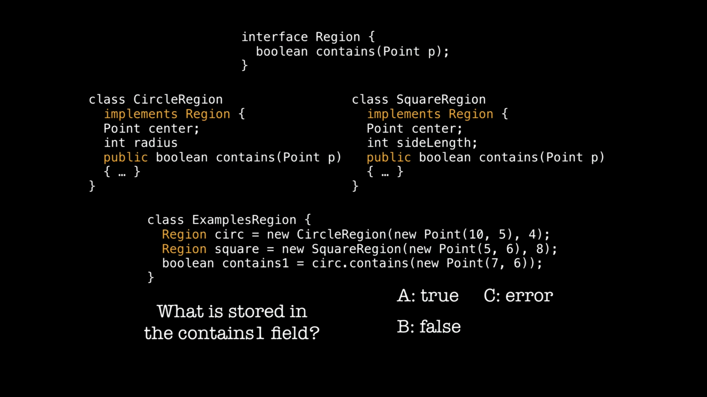

Slide 10
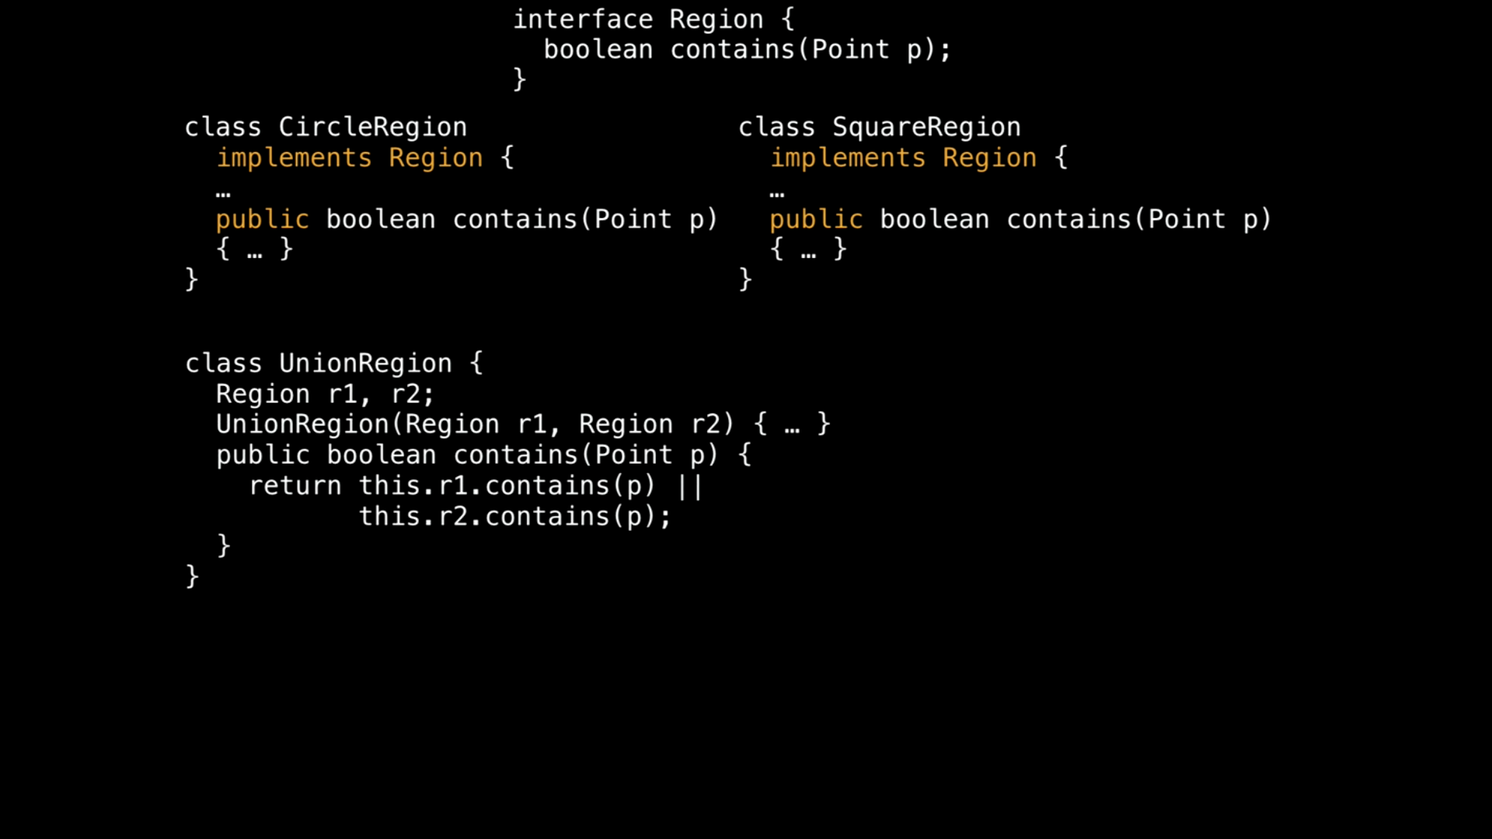

Slide 11
